Slide 1

Lloyds Banking Group AVD Bicep Workshop (2 days)
Michael Ross (CSA)

Slide 2
Agenda – Day 1
09:00 – Introductions
09:30 – Environmental Setup
10:15 – Break
10:30 – Bicep Review
12:00 – Lunch
13:00 – Building in Bicep – Base Infrastructure
15:00 – Break
15:15 – Building in Bicep – Base Infrastructure
16:30 – Day 1 review

Slide 3
Agenda – Day 2
09:00 – Review of Day 1
09:30 – Building in Bicep - AVD
10:15 – Break
10:30 – Building in Bicep - AVD
12:00 – Lunch
13:00 – Open Afternoon Q&A
15:00 – Break
16:30 – Workshop review

Slide 4

Workshop Day 1

Slide 5

Introductions
MICHAEL ROSS
Microsoft Cloud Solution Architect
With Microsoft only since November
Been working with:
RDS (on-prem) with SCCM since 2013
Azure since 2014
ARM since 2015, Bicep since 2020
WVD (now AVD) since 2018
Automation and Infra-as-Code a big part of my career over the last 25 years
What about you?

Slide 6
The Plan
So what will we build?
Diagnostics using Log Analytics and Storage Account
Simple network infrastructure
Keyvault
Hostpool + Workspace and Application Group
Hosts
And the outcomes?
Learn Bicep in practice
Learn how an AVD solution hangs together including resources, hosts and identities
A basic working AVD solution that you can log into using a provided identity

Slide 7
The Architecture

Slide 8
Environmental Setup
You should have the following:
Contributor Access to an Azure Subscription
Visual Studio Code
The ability to run PowerShell
Recommended VSCode Extensions
Azure Tools
Azure Resources
Bicep Extension
PowerShell

Slide 9
Environmental Setup
Setting up PowerShell
Install Azure Powershell Module
Set-ExecutionPolicy -ExecutionPolicy RemoteSigned -Scope CurrentUser
Install-Module -Name Az -Scope CurrentUser -Repository PSGallery -Force
Code Base
Create a folder for the code base to sit in
In VSCode select Source Control
Clone Repository: https://github.com/mikerossms/AVD-Bicep-LBG.git
Select the folder you created earlier
This repo provides both template and full examples of the code base we will be using for the next two days

Slide 10
Environmental Setup
Test the setup
Check the Code Base in VSCode
Open a Terminal in VSCode
Have a look at the README.md in root folder (you and preview MD files by using Ctrl+Shift+V OR Ctrl+K V)
Run through it and confirm you can access, create and delete resources.
For Reference
Tenant Name: xxx (ID)
Subscription Name: xxx (ID)

Slide 11
Environmental Setup
Code Base Introduction
Code base contains both Template and Full code deployments. We will be using the Template version
Template Bicep files can be found in: AVD-Code/TemplateCode/Bicep
Template code gives you the bare bones to fill out
Backplane.bicep is the master that sets up networking, hostpool and hosts
Network.bicep adds the vnets, subnets and nsg’s
Keyvault.bicep adds a bicep for credentials
Hostpool.bicep deploys the AVD hostpool and supporting components
Hosts.bicep deploys a number of hosts you can log in to
Diagnostics.bicep is a stand-alone deployment that sets up the diagnostics for the other modules to use

Slide 12
Environmental Setup
Code Base Introduction
AVD-Code/TemplateCode/Script contains a deployment script called deploy.ps1
Deploy.ps1 is a bare bones deployment script that provides commented out code snippets you can modify and use for deploying your bicep

Slide 13
User Accounts
Name | User Name | Password | Unique ID | VNET CIDR
Name | Azure login name | Init Az pwd | 001 | 10.201.1.0/24
Name | Azure login name | Init Az pwd | 002 | 10.201.2.0/24
Name | Azure login name | Init Az pwd | 003 | 10.201.3.0/24
Name | Azure login name | Init Az pwd | 004 | 10.201.4.0/24
Name | Azure login name | Init Az pwd | 005 | 10.201.5.0/24
Name | Azure login name | Init Az pwd | 006 | 10.201.6.0/24
Name | Azure login name | Init Az pwd | 007 | 10.201.7.0/24
Name | Azure login name | Init Az pwd | 008 | 10.201.8.0/24
Name | Azure login name | Init Az pwd | 009 | 10.201.9.0/24
Name | Azure login name | Init Az pwd | 010 | 10.201.10.0/24
Accounts are disabled. Once enabled head to: https://portal.azure.com and log in with the details above. You will need to provide a new password AND will need to provide a multifactor authentication option e.g. authenticator, email, phone etc.
NOTE: These accounts will be destroyed at the end of the course along with any personal details associated.

Slide 14
Break Time Back in 15 mins
"Infrastructure as code: because who doesn't love spending their days automating things that used to be done manually and breaking things in new and exciting ways?”

Slide 15

Bicep Review

Slide 16
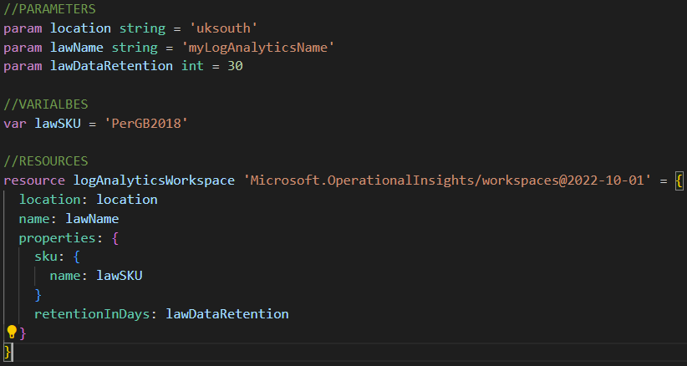
Bicep Review
Common Structure
Each bicep file follows a common pattern:
Define Parameters
Define Variables (if required)
Define Resources and/or modules
For example:
More Info: https://learn.microsoft.com/en-us/azure/azure-resource-manager/bicep/file

Slide 17
Bicep Review
Resources and Modules
These are the main components within a Bicep file and define Azure resources to deploy
What is the difference?
Resources deploy an actual “thing” to Azure using the defined API for that specific resource
Modules are more abstract and could be considered a group of resources. Modules can contain also contain other modules as well as resources.
In ARM terms, a module creates a nested ARM template.
Modules can also be in a different Scope to the rest of the Bicep file being deployed.

Slide 18
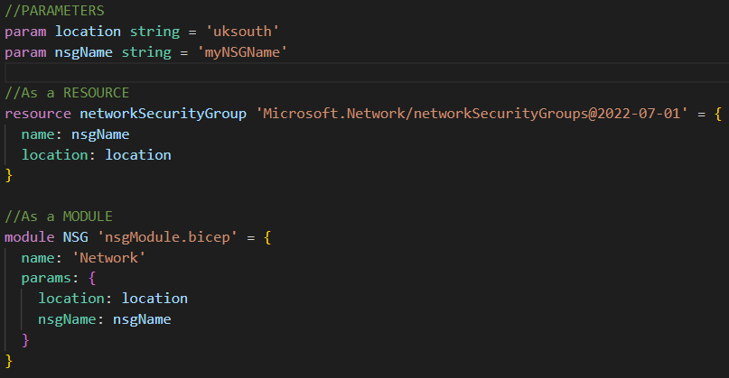
Bicep Review
Resource vs Module Examples
Notice:
They both have a name, but where a resource Name, is the actual name of the deployed resource, a module name is only a placeholder.
They are both provided the same parameters but in a different way
Resources use the API and Module calls another Bicep file (in the same directory in this case)
More Info: https://learn.microsoft.com/en-us/azure/azure-resource-manager/bicep/modules

Slide 19
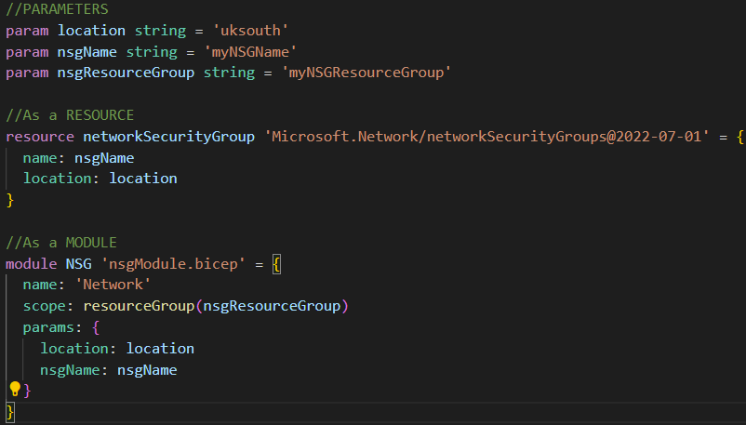
Bicep Review
What is Scope?
Very simply, this is where the resource is to be deployed.
Scope tends to be the preserve of Modules. Take a look at this code – what is the outcome of the Module NSG?
More Info: https://learn.microsoft.com/en-us/azure/azure-resource-manager/bicep/scope-extension-resources

Slide 20
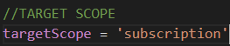
Bicep Review
The targetScope
This scope affects the level at which Bicep deploys. It can be of four different types:
Tenant
ManagementGroup
Subscription
ResourceGroup (the default)
Most Bicep is deployed a Resource Group level hence it is also the default scope.
Q: If this code was at the top of your Bicep file what resources could I deploy?
More Info: https://learn.microsoft.com/en-us/azure/azure-resource-manager/bicep/deploy-to-resource-group?tabs=azure-cli

Slide 21
Bicep Review
Bicep Functions, Loops and Conditions
Apart from looking much neater than an ARM template, there is a lot more that Bicep can do than just deploy resources.
Loops – provide a way to define multiple copies of resources, modules, variables, properties or outputs. Can work with both arrays and objects.
Conditions – If a module or resource should be deployed. Can also be used to determine a value of a variable or property
Operators – To calculate, compare or evaluate values or conditions
Functions – An action to perform on a parameter or variable. Common ones include:
- String functions: toLower, toUpper, concat, trim - Array functions: contains, indexOf, length, concat - Object functions: contains, length, items - Resource functions: getSecret, reference, resourceId

Slide 22
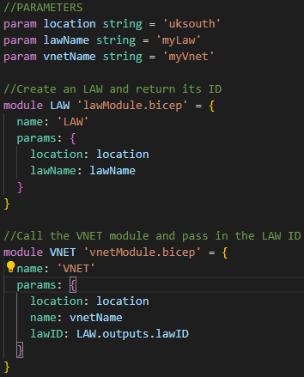
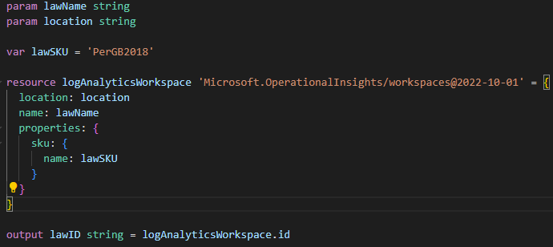
Bicep Review
Outputs
Provides a means for both Modules to return values to their parent (calling) module and for the parent module to return values to the script
Example:
More Info: https://learn.microsoft.com/en-us/azure/azure-resource-manager/bicep/outputs?tabs=azure-powershell

Slide 23
Lunch Back in 1 hour
"Using Azure Bicep is like having a sous chef for your cloud infrastructure. It takes care of the heavy lifting, so you can focus on the creative aspects of building your application. Just don't let it near your recipe book - you never know what kind of cloud-native concoctions it might come up with!"

Slide 24
Base Infrastructure
Time to get building
In this session we will be building out the base infrastructure to support (and is required by) AVD.
Diagnostics – LAW and Storage Account (walkthrough)
The Backplane (walkthrough)
Keyvault
NSG, Virtual Network and Subnet
If we have time:
Peering (walkthrough)

Slide 25
Deploying your Bicep
So how do I deploy my Bicep Code?
Your deployment will have a folder called Script within the TemplateCode folder.
This script is called deploy.ps1
Running it will deploy the Bicep code and subsequent resources
It takes several parameters, two of which are mandatory
.\deploy.ps1 -uniqueIdentifier “Provided unique ID" -avdVnetCIDR "provided CIDR“
Always use the same CIDR and Unique ID when deploying to avoid conflicts.
More information can be found in the README.md file

Slide 26
Break Back in 15 mins
"Using Azure Bicep is like a carpenter using power tools for the first time. It can be scary at first, but once you get the hang of it, you'll wonder how you ever managed without it. And just like with power tools, you'll want to make sure you wear your safety glasses and have a first-aid kit handy!“
Mark Russinovich, CTO of Microsoft Azure

Slide 27
Base Infrastructure
Continuing the build
In this session we will be building out the base infrastructure to support (and is required by) AVD.
Diagnostics – LAW and Storage Account (walkthrough)
The Backplane (walkthrough)
Keyvault
NSG, Virtual Network and Subnet
If we have time:
Peering (walkthrough)

Slide 28

See you all tomorrow

